Slide 1
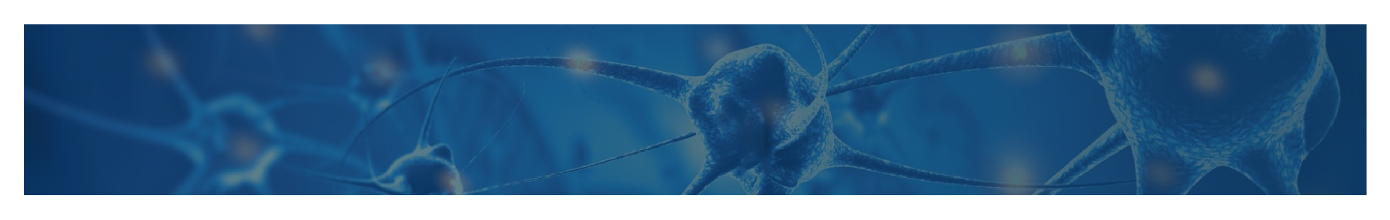


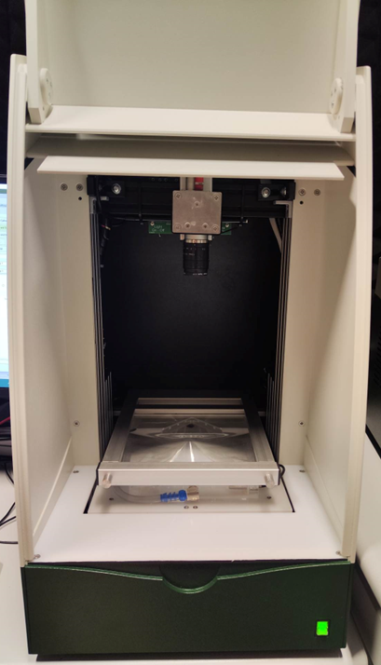
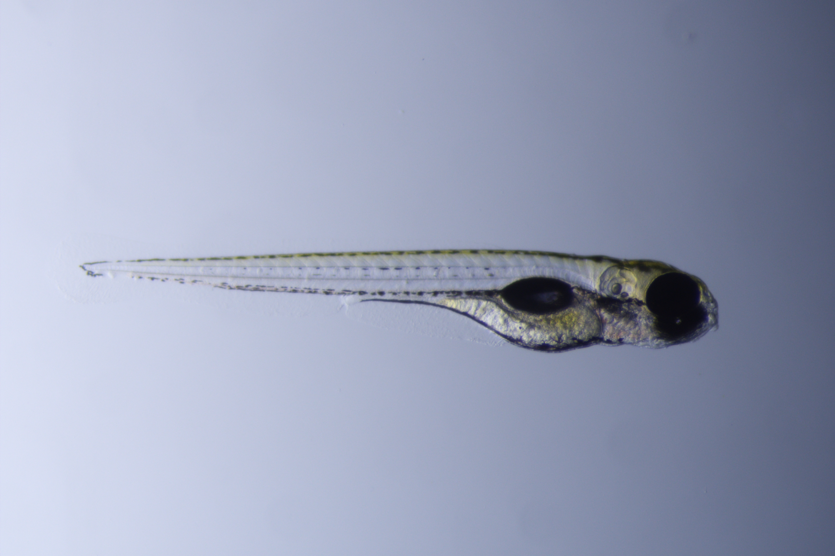
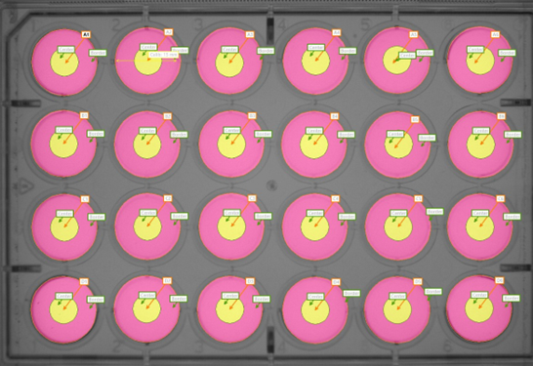
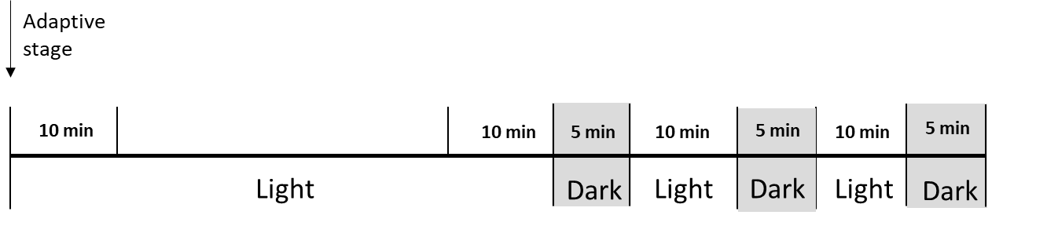
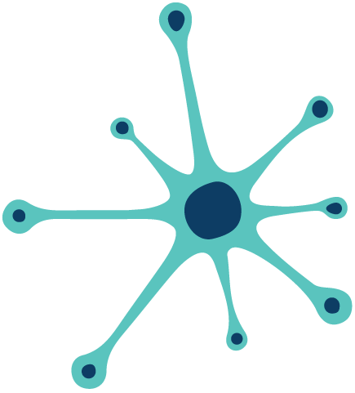

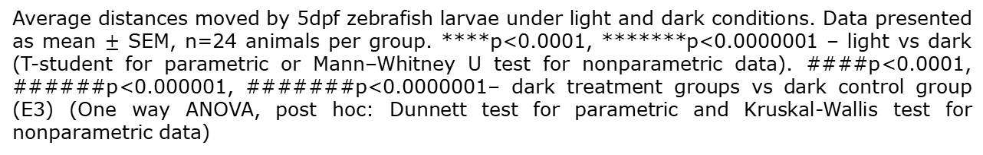
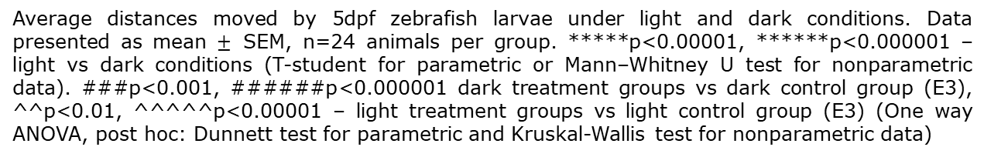
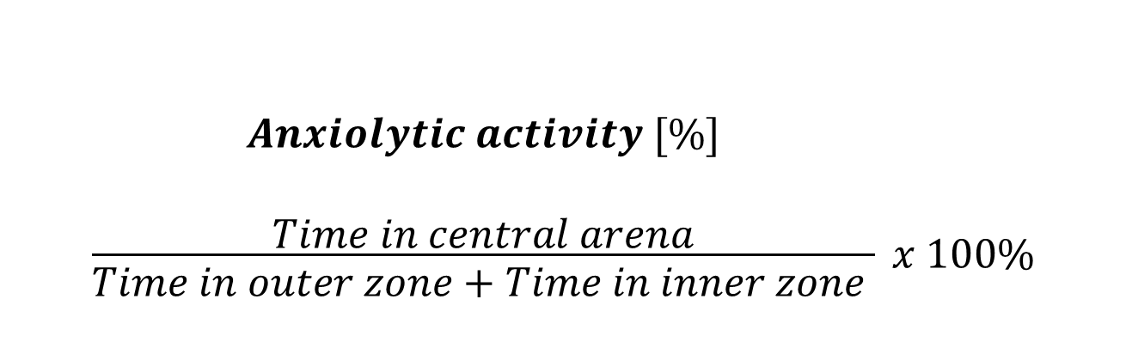
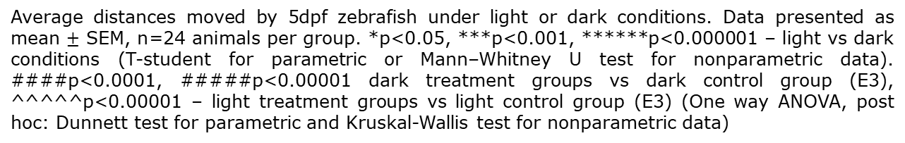
Evaluation of Anxiolytic Potential of Amitriptyline, Fluoxetine, and TP003 in Zebrafish Larvae Using
the Light-Dark Challenge Assay
Małgorzata Potoczna ^{1,2}, Ewa Sokołowska ¹, Piotr Podlasz ²
1. Transpharmation Poland Ltd., ul. Michała Oczapowskiego 13/105D, 10-719 Olsztyn, Poland
2. Department of Pathophysiology, Forensic Veterinary Medicine and Administration, Faculty of Veterinary Medicine, University of Warmia and Mazury in Olsztyn, ul. Michała Oczapowskiego 13, 10-719 Olsztyn, Poland
Introduction
The evaluation of the anxiolytic potential in preclinical models is crucial for developing effective treatments for anxiety disorders. Zebrafish larvae have emerged as a valuable tool in drug discovery due to their genetic similarity to humans and their rapid development, making them ideal candidates for
the high-throughput screening.
In this study, we aim to assess the anxiolytic effects of two commonly used antidepressant drugs: amitriptyline, fluoxetine, and one novel compound called TP003; non-selective benzodiazepine site agonist that induces anxiolysis via α2GABA_{A} receptors.
The Light-Dark Challenge test (L-DC) has been utilized as an assay reflecting larval anxiety-like behaviour (response to light and dark). Additionally, thigmotaxis measurement has been conducted.
Experimental design Measured parameters
Distance moved [mm] – shows the average distance which larvae have travelled in 1-min time bins under changing: light and dark phase
5 days post fertilization(dpf) zebrafish AB larvae
30 minutes of incubation with a drug on 24-well plate (arenas divided to inner and outer zone)
Anxiolytic activity [%] – shows the percentage of the time the larvae spent in the centre of the arena under the changing conditions.
Automatic tracking of larvae movement (Danio Vision®)
$$\frac{\begin{aligned}Anxiolytic activity [\%] \\ \\ Time in central arena\end{aligned}}{Time in outer zone+Time in inner zone } x 100\%$$
Results
Anxiolytics effect of amitriptyline (AMY)
Timeline
Distance moved in L-DC
Anxiolytic Activity (Thigmotaxis)
Combined results from 4 independent repetitions, n=24
Average distances moved by 5dpf zebrafish larvae under light and dark conditions. Data presented as mean $±$ SEM, n=24 animals per group. *****p<0.00001, ******p<0.000001 – light vs dark conditions (T-student for parametric or Mann–Whitney U test for nonparametric data). ###p<0.001, ######p<0.000001 dark treatment groups vs dark control group (E3), ^^p<0.01, ^^^^^p<0.00001 – light treatment groups vs light control group (E3) (One way ANOVA, post hoc: Dunnett test for parametric and Kruskal-Wallis test for nonparametric data)
The percentage of time spent by 5dpf zebrafish larvae in the central area. Data presented as mean ± SEM, n=24. *p<0.05, **p<0.01, ******p<0.000001 – light vs dark conditions (T-student for parametric or Mann–Whitney U test for nonparametric data. ##p<0.01 dark treatment groups vs dark control group (E3), ^^p<0.01, – light treatment groups vs light control group (E3) (One way ANOVA, post hoc: Dunnett test for parametric and Kruskal-Wallis test for nonparametric data)
Anxiolytics effect of fluoxetine (FLU)
Distance moved in L-DC
Anxiolytic Activity (Thigmotaxis)
Timeline
Combined results from 4 independent repetitions, n=24
Anxiolytics effect of TP003
Average distances moved by 5dpf zebrafish under light or dark conditions. Data presented as mean $±$ SEM, n=24 animals per group. *p<0.05, ***p<0.001, ******p<0.000001 – light vs dark conditions (T-student for parametric or Mann–Whitney U test for nonparametric data). ####p<0.0001, #####p<0.00001 dark treatment groups vs dark control group (E3), ^^^^^p<0.00001 – light treatment groups vs light control group (E3) (One way ANOVA, post hoc: Dunnett test for parametric and Kruskal-Wallis test for nonparametric data)
The percentage of time spent by 5dpf zebrafish larvae in the central area. Data presented as mean ± SEM, n=24. p<0.01, ***p<0.001 ****p<0.0001 – light vs dark conditions (T-student for parametric or Mann–Whitney U test for nonparametric data. #p<0.05, ####p<0.0001 dark treatment groups vs dark control group (E3), ^^^p<0.001, – light treatment groups vs light control group (E3) (One way ANOVA, post hoc: Dunnett test for parametric and Kruskal-Wallis test for nonparametric data)
Timeline
Distance moved in L-DC
Anxiolytic Activity (Thigmotaxis)
Combined results from 4 independent repetitions, n=24
Average distances moved by 5dpf zebrafish larvae under light and dark conditions. Data presented as mean $±$ SEM, n=24 animals per group. ****p<0.0001, *******p<0.0000001 – light vs dark (T-student for parametric or Mann–Whitney U test for nonparametric data). ####p<0.0001, ######p<0.000001, #######p<0.0000001– dark treatment groups vs dark control group (E3) (One way ANOVA, post hoc: Dunnett test for parametric and Kruskal-Wallis test for nonparametric data)
The percentage of time spent by 5dpf zebrafish larvae in the central area. Data presented as mean ± SEM, n=24, ****p<0.0001, ******p<0.000001 – light vs dark conditions (T-student for parametric or Mann–Whitney U test for nonparametric data. ^^^^p<0.0001– light treatment groups vs light control group (E3) (One way ANOVA, post hoc: Dunnett test for parametric and Kruskal-Wallis test for nonparametric data)
Conclusions
All tested substances exhibit an anxiolytic effect, albeit with varying levels of efficacy contingent upon the administered dosage.
Our results provide further evidence supporting the use of TP003 as a potential therapeutic option for anxiety-related disorders.
Collected data contribute to our understanding of the mechanisms underlying anxiety and provide a foundation for future research on the development of novel treatments.
The Light-Dark Challenge assay is a reliable tool for anxiolytic efficacy testing in zebrafish larvae model.

